Slide 1
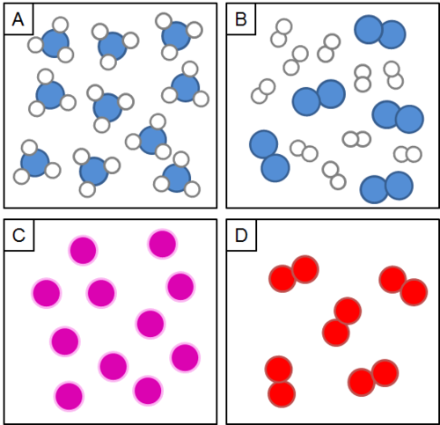
Do Now
Label the pictures using these names:
compound,
element,
molecular element,
mixture

Slide 2
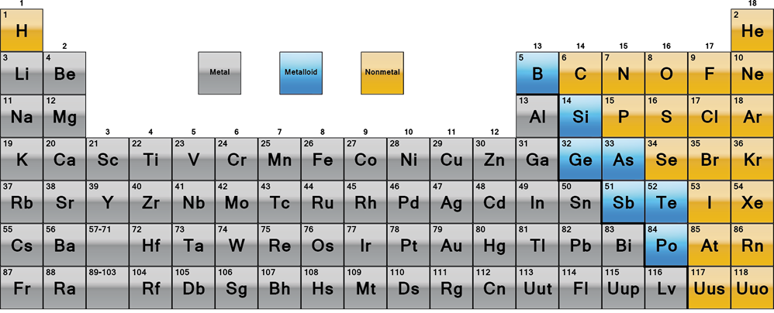
Daily Review
CFU 1
Write the names and symbols of two metals.
Elements on the periodic table are arranged according to their properties.
CFU 2
Write the names and symbols of two non-metals.
Every element is either a metal, a non-metal or a metalloid.
CFU 3
Write the names and symbols of two metalloids.

Slide 3
Daily Review
Elements on the periodic table are arranged according to their properties.
On your whiteboard, classify the properties below as belonging to metals or non-metals.
malleable, dull, brittle, shiny, does not conduct electricity
Vocabulary
malleable (adjective) can change shape without breaking or cracking brittle (adjective) hard, but cannot change shape without breaking or cracking
Metals | Non-metals

Slide 4
Daily Review
Chemical formulae show the types and number of elements in a molecule.
Which elements and how many of each are in sodium oxide if the formula is Na₂O?
Which elements and how many of each are in sulfuric acid if the formula is H₂SO₄?
Which elements and how many of each are in lithium carbonate if the formula is Li₂CO₃?
Reminders
The number after the symbol tells you how many atoms of that element the molecule has. If there is no number, there is just one atom of that element.

Slide 5
Naming Compounds Year 8 Science

Slide 6
Learning Objectives
CFU
What two types of compounds are we going to learn about?
Define compounds
Name and write the formulae of simple compounds using scientific conventions
Activate Prior Knowledge
Divide your whiteboard into three columns: Metals, Non-Metals and Mixed.
Classify the following substances by placing them in the appropriate column: Metals if they only have metal atoms, Non-Metals if they only have non-metal atoms, and Mixed if they have both.
H₂O CO₂ Ag NaCℓ
CuSO₄ Fe KMnO₄ AℓPO₄

Slide 7
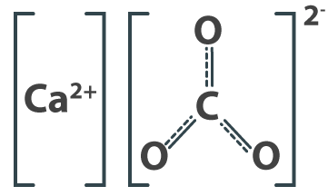
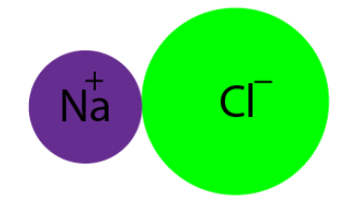
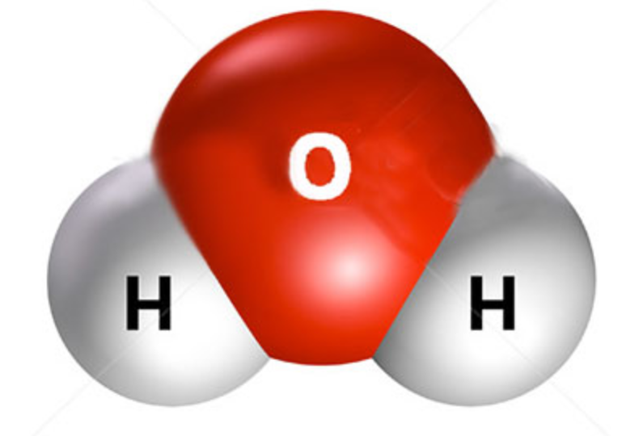
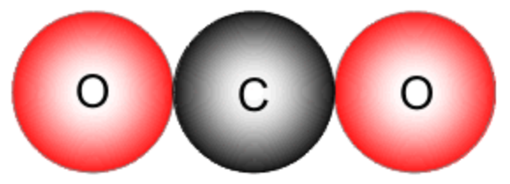
Concept Development
CFU 1
What is the rule for naming a compound when a metal and non-metal is included?
Compounds: metal + non-metal e.g. Calcium carbonate: CaCO₃ Sodium chloride (table salt): NaCℓ
Compounds: non-metal + non-metal
CFU 2
What is the rule for naming a compound when a non-metal and a non-metal is included?
e.g. Dihydrogen monoxide (water) Carbon dioxide

Slide 8
Skill Development / Guided Practice
CFU 1
What part of the compound is written first?
There are some rules for naming chemical compounds.
Naming Compounds [metal – non-metal]
Write the name of the metal first
Write the name of the non-metal second and change the ending to –ide
i.e. hydrogen → hydride
oxygen → oxide
nitrogen → nitride
chlorine → chloride
fluorine → fluoride
bromine → bromide
CFU 2
How is the name of the non-metal changed?
CFU 3
How would you change “sulfur” when there is a metal and a non-metal is included in naming compounds?

Slide 9
Skill Development / Guided Practice
CFU 1
What part of the compound is written first?
There are some rules for naming chemical compounds.
Naming Compounds [metal – non-metal]
Write the name of the metal first
Write the name of the non-metal second and change the ending to –ide
CFU 2
What is the metal in the chemical formula?
Chemical formula: MgO
Write the name of the metal first
Magnesium
Write the name of the non-metal second
Magnesium oxygen
Change the ending of the non-metal to -ide
Magnesium oxide
CFU 3
What is the non-metal in the chemical formula?
CFU 4
How is the name of the non-metal changed?
Hint
The numbers are not involved when a metal and a non-metal is involved while writing compound formula.

Slide 10
Skill Development / Guided Practice
CFU 1
What part of the compound is written first?
There are some rules for naming chemical compounds.
Naming Compounds [metal – non-metal]
Write the name of the metal first
Write the name of the non-metal second and change the ending to –ide
CFU 2
What is the metal in the chemical formula?
Chemical formula: Aℓ₂S₃
Write the name of the metal first
Aluminium
Write the name of the non-metal second
Aluminium sulfur
Change the ending of the non-metal to -ide
CFU 3
What is the non-metal in the chemical formula?
CFU 4
How is the name of the non-metal changed?
Hint
The numbers are not involved when a metal and a non-metal is involved while writing compound formula.

Slide 11
Skill Development / Guided Practice
CFU 1
What part of the compound is written first?
There are some rules for naming chemical compounds.
Naming Compounds [metal – non-metal]
Write the name of the metal first
Write the name of the non-metal second and change the ending to –ide
CFU 2
What is the metal in the chemical formula?
Chemical formula: CaCℓ₂
Write the name of the metal first
Write the name of the non-metal second
Change the ending of the non-metal to -ide
CFU 3
What is the non-metal in the chemical formula?
CFU 4
How is the name of the non-metal changed?
Hint
The numbers are not involved when a metal and a non-metal is involved while writing compound formula.

Slide 12
Skill Development / Guided Practice
CFU 1
In what order are the elements written?
There are some rules for naming chemical compounds.
Naming Compounds [non-metal – non-metal]
Write the elements in the order they appear in the formula
Use a prefix to show how many atoms there are * If there is only one atom of the first element, no prefix is needed
The ending of the last element is changed to –ide
i.e. one = mono
two = di
three = tri
four = tetra
CFU 2
Where is the prefix put and what does it show?
CFU 3
What do you do to the ending of the last element name?
CFU 4
Where have you seen one of these prefixes before?
Reminder:
Each new atom begins with a CAPITAL letter.
Notes:
Have students complete first table on worksheet, provide answers to ensure accuracy

Slide 13
Skill Development / Guided Practice
CFU 1
In what order are the elements written?
There are some rules for naming chemical compounds.
Naming Compounds [non-metal – non-metal]
Write the elements in the order they appear in the formula
A prefix is put in front of each element to show how many there are
If there is only one atom of the first element, no prefix is needed
The ending of the last element is changed to –ide
CFU 2
Where is the prefix put and what does it show?
CFU 3
What do you do to the ending of the last element name?
Chemical formula: H₂O
Write the elements in order
Hydrogen oxygen
Add prefixes to show how many atoms of each there are
Dihydrogen monoxygen
Change the ending of the last element to -ide
Dihydrogen monoxide
Hint:
One: mono Two: di Three: tri Four: tetra

Slide 14
Skill Development / Guided Practice
CFU 1
In what order are the elements written?
There are some rules for naming chemical compounds.
Naming Compounds [non-metal – non-metal]
Write the elements in the order they appear in the formula
A prefix is put in front of each element to show how many there are
If there is only one atom of the first element, no prefix is needed
The ending of the last element is changed to –ide
CFU 2
Where is the prefix put and what does it show?
CFU 3
What do you do to the ending of the last element name?
Chemical formula: SO₂
Write the elements in order
Sulfur oxygen
Add prefixes to show how many atoms of each there are
Sulfur dioxygen
Change the ending of the last element to -ide
Sulfur dioxide
Hint:
One: mono Two: di Three: tri Four: tetra

Slide 15
Skill Development / Guided Practice
CFU 1
In what order are the elements written?
There are some rules for naming chemical compounds.
Naming Compounds [non-metal – non-metal]
Write the elements in the order they appear in the formula
A prefix is put in front of each element to show how many there are
If there is only one atom of the first element, no prefix is needed
The ending of the last element is changed to –ide
CFU 2
Where is the prefix put and what does it show?
CFU 3
What do you do to the ending of the last element name?
Chemical formula: NF₃
Write the elements in order
Nitrogen fluorine
Add prefixes to show how many atoms of each there are
Change the ending of the last element to -ide
Hint:
One: mono Two: di Three: tri Four: tetra

Slide 16
Skill Development / Guided Practice
CFU 1
In what order are the elements written?
There are some rules for naming chemical compounds.
Naming Compounds [non-metal – non-metal]
Write the elements in the order they appear in the formula
A prefix is put in front of each element to show how many there are
If there is only one atom of the first element, no prefix is needed
The ending of the last element is changed to –ide
CFU 2
Where is the prefix put and what does it show?
CFU 3
What do you do to the ending of the last element name?
Chemical formula: N₂O
Write the elements in order
Add prefixes to show how many atoms of each there are
Change the ending of the last element to -ide
Hint:
One: mono Two: di Three: tri Four: tetra

Slide 17
Skill Development / Guided Practice
CFU 1
In what order are the elements written?
There are some rules for naming chemical compounds.
Naming Compounds [non-metal – non-metal]
Write the elements in the order they appear in the formula
A prefix is put in front of each element to show how many there are
If there is only one atom of the first element, no prefix is needed
The ending of the last element is changed to –ide
CFU 2
Where is the prefix put and what does it show?
CFU 3
What do you do to the ending of the last element name?
Chemical formula: CCℓ₄
Write the elements in order
Add prefixes to show how many atoms of each there are
Change the ending of the last element to -ide
Hint:
One: mono Two: di Three: tri Four: tetra

Slide 18
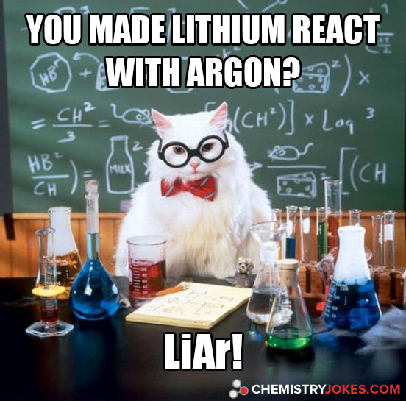
Relevance
Identifying the type and number of atoms in a substance helps us determine its structure and properties.
Knowing the chemical formulae and names of compounds will help you read labels on chemical bottles during experiments.
It also helps you understand bad chemistry jokes ☺

Slide 19
Skill Closure
Write the name for this compound – Aℓ₂O₃
Naming Compounds [metal – non-metal]
Write the name of the metal first
Write the name of the non-metal second and change the ending to –ide
Skill Closure
Write the name for this compound – CO
Naming Compounds [non-metal – non-metal]
Write the elements in the order they appear in the formula
A prefix is put in front of each element to show how many there are
If there is only one atom of the first element, no prefix is needed
The ending of the last element is changed to –ide
Skill Closure
A student wrote the name for NaCℓ as Chlorine sodium. Is this correct? Explain your answer.

Slide 20
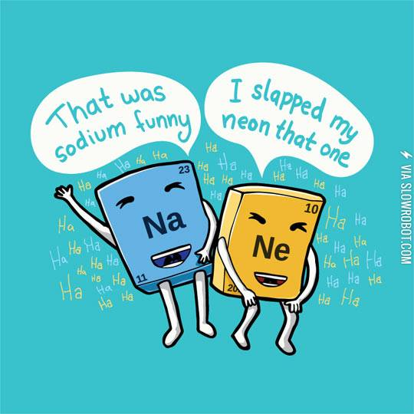
Independent Practice
Complete the Naming Compounds worksheet by:
Downloading from Connect on your device, OR
Collecting a printout from your teacher

